Slide 1
Lambton College in Toronto
CBD 2214: Big Data Fundamentals
Linear Regression Model
Team Members: Ralph Christian
Usnik Biswas
Ajay Sharma

Slide 2
Theory
Understanding Linear Regression: Linear Regression is the supervised Machine Learning, in which the program finds the best fit linear line between the independent variable, that is, it finds linear relationship between the dependent and the independent variable.

Slide 3
What is “Linear”?
Remember this:
Y=mX+B?
m
B

Slide 4
What’s Slope?
A slope is the ratio of x is to y, that is, how much does y increase when there is an increase of 1 unit in x.
A slope shows you how much steep or how much flat a line is.
A slope of 2 means that every 1-unit change in X yields a 2-unit change in Y.

Slide 5
Linear Correlation
Linear relationships
Curvilinear relationships
Y
Y
X
X
Y
Y
X
X
Slide from: Statistics for Managers Using Microsoft® Excel 4th Edition, 2004 Prentice-Hall

Slide 6
Linear Correlation
Strong relationships
Weak relationships
Y
Y
X
X
Y
Y
X
X
Slide from: Statistics for Managers Using Microsoft® Excel 4th Edition, 2004 Prentice-Hall

Slide 7
Linear Correlation
No relationship
Y
X
Y
X
Slide from: Statistics for Managers Using Microsoft® Excel 4th Edition, 2004 Prentice-Hall

Slide 8
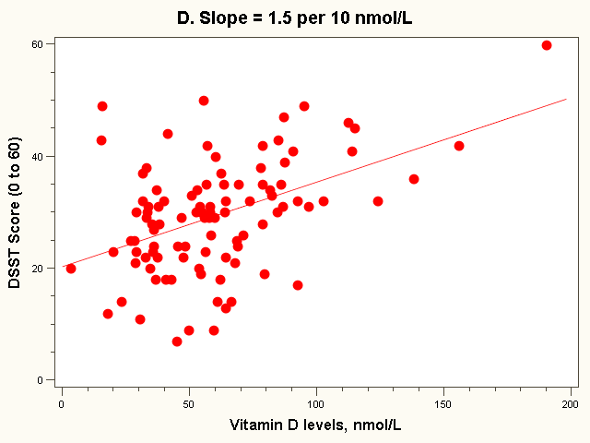
The “Best fit” line
Regression equation:
E(Yi) = 20 + 1.5*vit Di (in 10 nmol/L)
Note: all the lines go through the point (63, 28)!

Slide 9
Linear regression
In correlation, the two variables are treated as equals. In regression, one variable is considered independent (=predictor) variable (X) and the other the dependent (=outcome) variable Y.

Slide 10
Assumptions in Linear Regression
Linearity: It means that dependent variable y should be linearly related to independent variable x.
Normality: Both the variables should be normally distributed, example: bell curve.
Independence: The independent variables should have no corelations among each other, their VIF score should be less than 5.

Slide 11
Prediction
If you know something about X, this knowledge helps you predict something about Y. (Sound familiar?…sound like conditional probabilities?)

Slide 12
Data Set
Any type of prediction or analysis depends on the dataset that is given to the model, the data needs to be selected and collected from proper sources, and the data needs to be of high veracity to have better value.

Slide 13
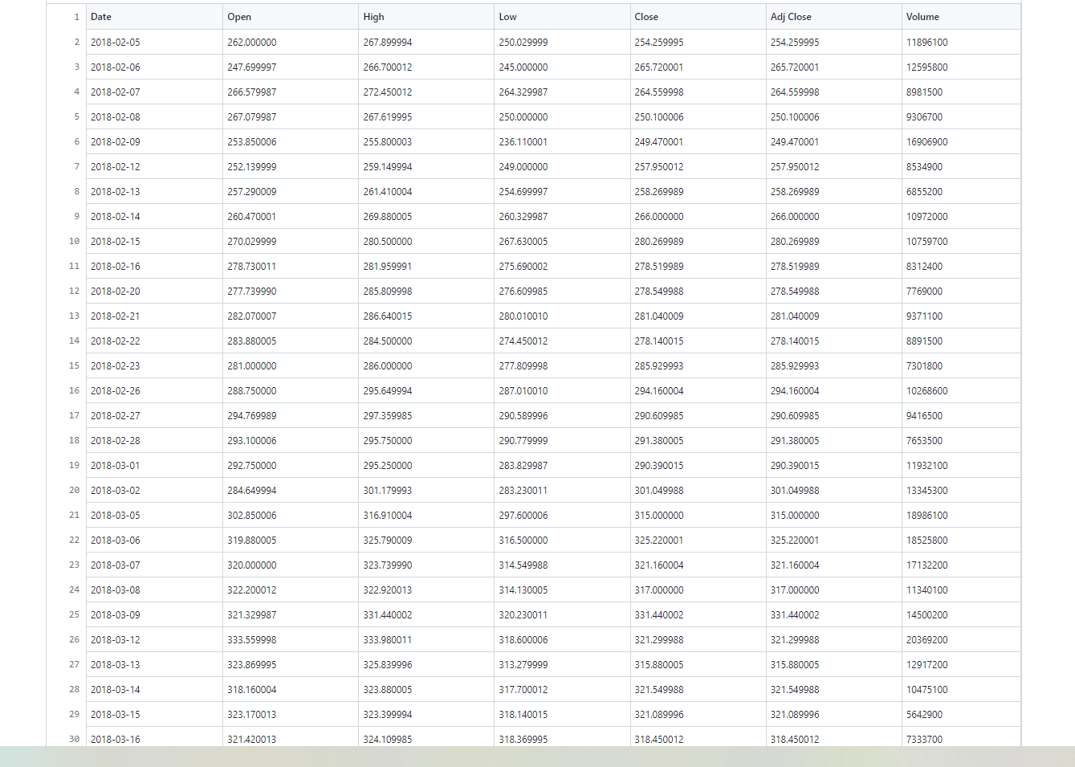

Slide 14
The data that we have selected is of the Netflix Stock prices starting from the date 05-02-2018.
Each line of data has 6 columns, namely, Date, Open, High, Low, Close, Adjacent Close and Volume.
  Open: Shows what value the stock opened on that particular day.
  High and Low shows the highest and the lowest value of the stock on that particular day.
  Close: What value did the stock close on that day.
  Volume: What is the amount of stock available in the market to purchase.

Slide 15
Pre-Processing Steps
Before the regression or any other big data analytics process is done, there are a few steps which are necessary to ensure that the whole cycle completes successfully and yields good results that are high in value.
These steps are called preprocessing steps and they include tasks like Data Procuring, Data Cleaning, and Imputation.

Slide 16
Few of the key features are:
Data Procuring: Data procuring is the process of data collection or mining, during this process the relevant data which was selected for the analysis during the data selection process is collected through various sources like external and internal. This data can be purchased from third party vendors as well and can be collected from company’s own database as well.
The results in the form of information and knowledge depends heavily on the type of data that is fed to the regressor and other analytics processes, hence cleaning of the data is also important. Data cleaning is the process of cleansing data and removing or solving any anomalies the are present in the data that can potentially skew the results.

Slide 17
Column Selection

Slide 18
The whole data set is not pushed into the regressor, that means, not all columns are essential to the prediction, which is why selecting a column is of utmost importance. Here we have selected the column “Close” to train the regressor and make predictions.
Close is defined as the final price of the day when trading stops for public, this column is selected because the price variation after the close is not because of buyers and sellers, hence making predictions based on that data will not be possible.
Selecting the close column will result in proper results that are based on the buyers and sellers dealing with the stock. Here we are splitting the data 80% to 20% using the following line:

Slide 19
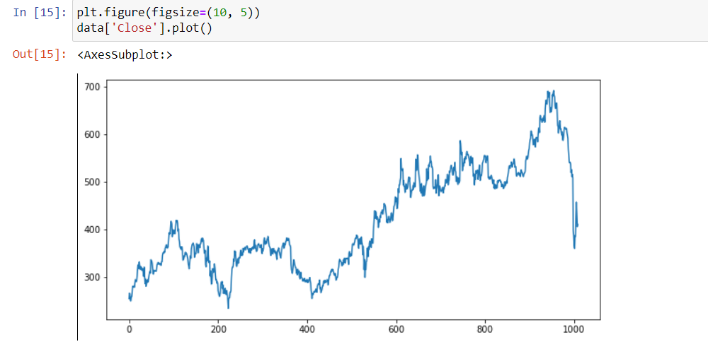


Slide 20
Linear Regressor
Here we have used a linear regression model to represent the relationship between input values that are plotted against two axes, those two axes are X and Y.
The regression model that we are using is a simple model that presumes the output values of Y given that we have the linear combination of values of Y. The form of the equation used is that of a slope which is MX + C, where M and C are the coefficients.

Slide 21
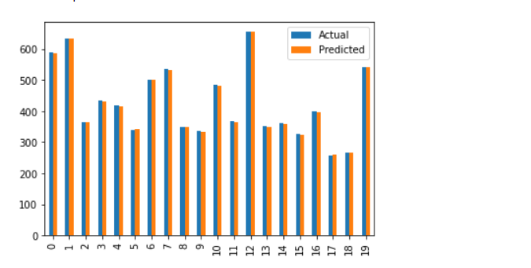
We are using the Linear Regress() module of Python.

Slide 22
After the regression is done and results are obtained, those results are passed through some parameters to determine their accuracy and value.
Mean Absolute Error: It is the error observed when comparing the predicted value to the actual value which is observed. It is more advantageous to compare this way instead of using mean square error which makes things more complicated.
Mean Squared Error: It is the difference between square of predicted value and the square of observed value, this is usually and appropriation for more complex cases.

Slide 23
Root Mean Square Error: This provides the standard deviation of the regression, and the data line points; this is basically the quadratic mean of predicted value and observed value.

Slide 24
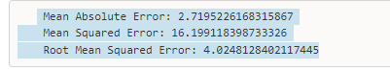
Our results for these parameters are:

Slide 25
Practical Presentation

Slide 26
Thank You!

